Slide 1
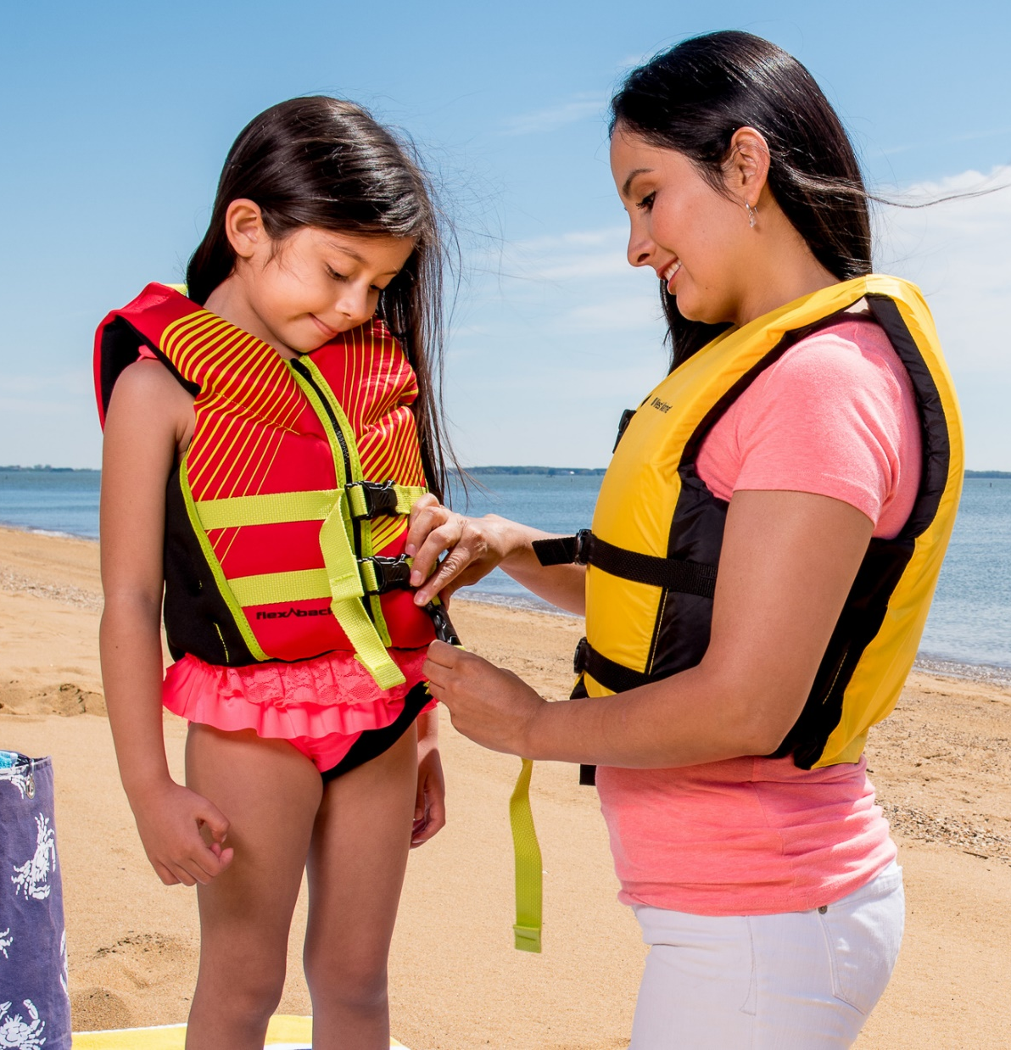

10 Tips for Open Water Safety
Keep your family safe at the river, lake, or ocean.

Slide 2

Introduction
Today’s Speaker
Notes:
Today’s presentation was created by Safe Kids Greater Sacramento. Made possible by funding from the US Coast Guard and Safe Kids Worldwide.

Slide 3
Notes:
Open water is defined as natural bodies of water, such as lakes, rivers, ponds, and oceans.

Slide 4
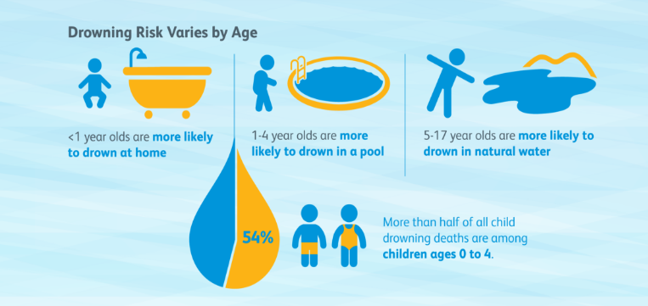
Drowning Risks
United States, Safe Kids Worldwide, 2016
Notes:
U.S. Statistics
Drowning is a leading cause of death for children; for children ages 1-14, drowning is the 2nd leading cause of unintentional injury death and is the 3rd leading cause among children ages 15-19.
As children age, the risk of open water drowning rises. In fact, in 2019, 70% of the children ages 15-19 who drowned, did so in natural or open waters.
Males are at the greatest risk of fatal drowning. The natural water fatal drowning rate is more than four times higher for boys compared to girls.
Drowning remains a leading cause of death for children with autism and accounts for approximately 90 percent of deaths associated with elopement (wandering) by those age 14 and younger.

Slide 5
Drowning Location
Sacramento County, Ages 0-17
Sacramento County CDRT, 2007-2016
Notes:
Drowning is the second leading cause of unintentional injury related death among Sacramento County children ages 0-17, following only motor vehicle traffic (CDPH EpiCenter, 2010-2019).
The Sacramento County Child Death Review Team reports that 50 children ages 0-17 died due to drowning from 2007-2016. 16 of those children died in open water.
Our drowning death statistics follow national trends, with younger children drowning in backyard pools more often, and older children typically drowning in open water.

Slide 6
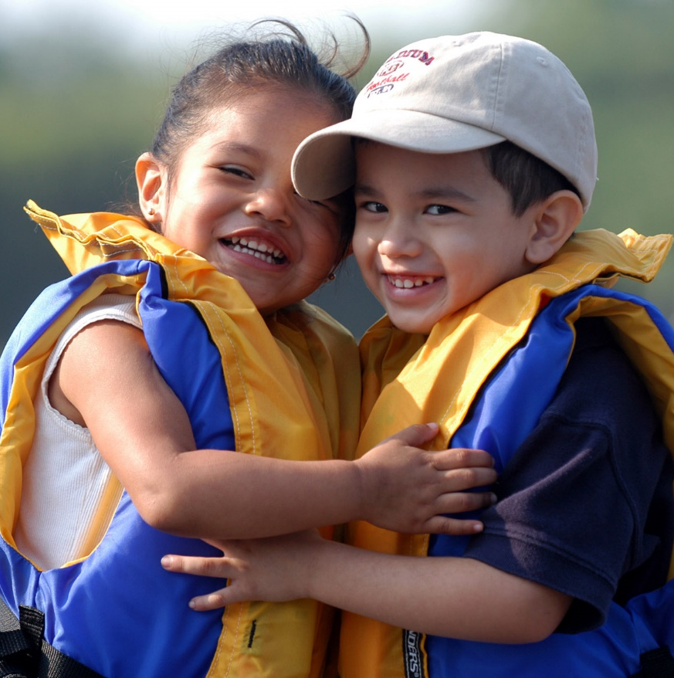
10 Tips for Open Water Safety
Notes:
10 Tips provided by the California Department of Parks, Division of Boating and Waterways

Slide 7
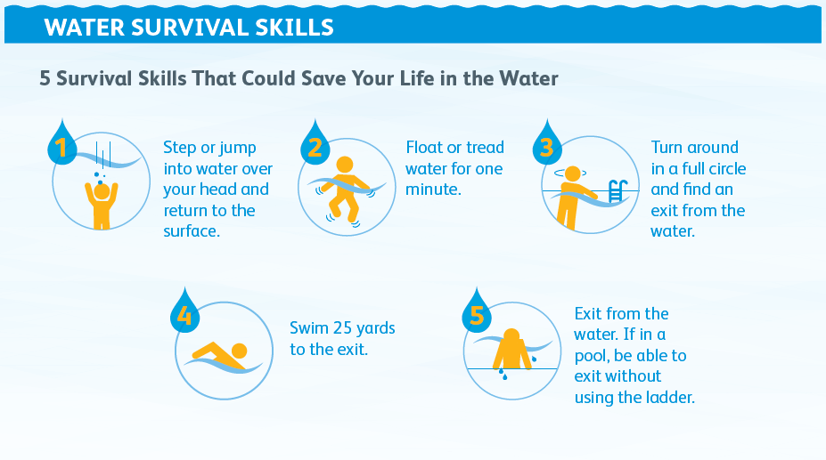
Learn to Swim
Notes:
Everyone should learn how to swim; it is a skill that can save your life
Every child is different, so enroll children in swim lessons when they are ready – consider their age, development and how often they are around water.
Make sure kids learn water survival skills. Children should be able to do these five things:
1. Step or jump into water over their head and return to the surface.
2. Turn around in the water and orient to safety.
3. Float or tread water.
4. Combine breathing with forward movement in the water.
5. Exit the water.
Teach children that swimming in open water is different from swimming in a pool. Know the hidden hazards of open water such as limited visibility, sudden drop-offs, uneven surfaces, currents and undertow.

Slide 8
Swim Safely
Swim with a buddy who knows how to swim. Keep younger children within arms reach in or near the water.
Swim where there is a lifeguard, and follow their instructions
Adults who know how to swim can take turns being a
Water Watcher for a set period of time.
Install, inspect and always use barriers .
Water Watchers face the water and avoid distractions
Notes:
Swim where there is a lifeguard.
Even when a lifeguard is on duty, you are responsible for watching your child.
Always obey the lifeguard or responsible adult. You may not know there is a hazard nearby, listen to the lifeguard, it will save your life.
Swim in a designated area reserved for swimmers. These areas are considered “safer” because there are less hazards, and the depth is known.
Swim with an adult or a buddy who knows how to swim
Install, inspect, and always use barriers between children and the water. With pools, this often means pool fences or covers. If your home or vacation home is near open water, this can mean using door locks and alarms, backyard fencing, fence gates that swing shut with a self-closing latch, and respecting signs and fences near public waterways.
More on Water Watchers on next slide!
Be aware of big waves and tides.
Big waves can knock the strongest person off their feet, never turn your back on the ocean and stay away from the water’s edge if you can’t swim and you are fully clothed.
Be aware that tides can change throughout the day
Wear sunscreen - Spending all day at the river can give you a painful sunburn. Be sure to wear SPF 15 or better and reapply frequently.
Don't get too tired! - People, especially children, can make unsafe choices when they are too tired.
Stay hydrated.
Watch out for hypothermia - If you experience excessive shivering or fatigue, get out of the water at once.

Slide 9
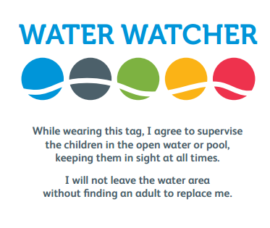

Water Watcher
http://www.safekids.org/other-resource/water-watcher-card
Notes:
Watch kids when they are in or around water, without being distracted. Keep young children and weak swimmers within arm’s reach of an adult.
Make sure older children swim with a partner every time.
Choose a Water Watcher. When there are several adults present, choose one to be responsible for watching children in or near the water for a certain period of time, such as 15 minutes. After 15 minutes, select another adult to be the Water Watcher.
Water Watchers should face the water at all times and avoid distractions.

Slide 10
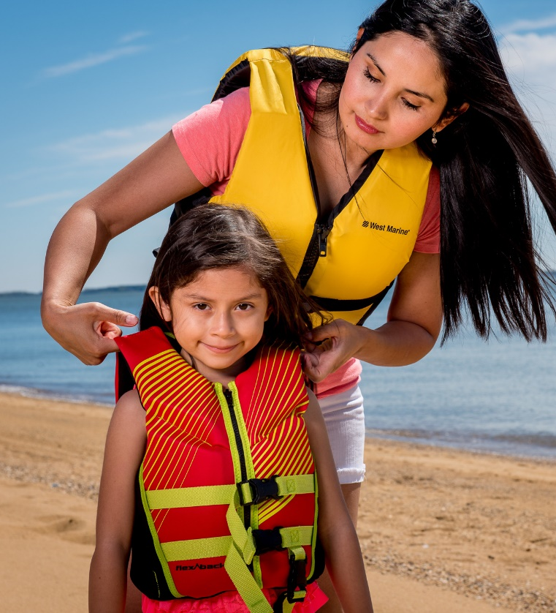
Wear a Life Jacket
Sacramento County – All children under 13 must wear life jackets when in waterways (rivers)
Use only US Coast Guard approved life jackets
Floaties and water wings are toys, not life-saving devices
Life jackets are not a substitute for Adult Supervision
Notes:
Why we wear life jackets
The Sacramento region is home to the American and Sacramento Rivers. These rivers originate from snow melt in the Sierra Nevada Mountains, and by the time they reach the Sacramento Valley, their waters are fast, cold, and full of debris.
Even the strongest swimmer can be pulled under.
Anyone on a raft, kayak, canoe, or inner tube should always wear a life jacket.
Floats, such as tubes, air mattresses or ‘floaties’ are toys and are not substitutes for a life jacket.
California and Sacramento laws
CA law states that all persons on board a personal watercraft (like a jet ski) and all persons being towed behind a vessel (as in water skiing) must wear a life jacket.
California law states that all children 13 and under must wear a properly fitting, U.S. Coast Guard-approved life jacket while underway on a vessel of 26 feet or less. https://dbw.parks.ca.gov/?page_id=28751
There is a Sacramento County ordinance requiring any child under the age of 13 to wear a life vest before accessing any public waters and violation of the ordinance punishes parents with a fine of $500 and/or six months in jail. It’s your responsibility to make sure your child is wearing a life vest. (Includes boating, swimming, and wading.) https://regionalparks.saccounty.gov/Rangers/Pages/RulesRegulationsLifeJacketOrdinance.aspx

Slide 11

Notes:
Play video
How to choose and fit a life jacket
Demonstrate how to properly fit a life jacket
Demonstrate what happens when a life jacket does not fit properly (too loose, slips off over head)
The Best life jacket is one that:
Fits properly
Is marked with a U.S. Coast Guard-approved number.
Is in good condition. At the beginning of each boating season:
Check that all hardware and straps are in good shape, firmly attached, and in working order.
Faded material can indicate loss of strength. Weathered lifejackets may tear more easily and can result in loss of flotation material.
Check for leaks, mildew, & oil saturation in the fabric.
Make sure there are no rips or tears in the fabric.
Make sure the label stating USCG approval is attached, and that it is readable.
Discard and replace life jackets that show signs of deterioration – faded material, tears, mildew stains, punctures, etc. When not in use, store lifejackets in a dry, cool, and dark place.
Has reflective tape and a whistle attached
Is the right type of life jacket for the type of swimming, boating, or water sports you will be doing.
Types of Life Jackets - https://dbw.parks.ca.gov/?page_id=29182
If a life jacket fits properly...
It will help keep your head above the water.
If it's too big, the life jacket will ride up around your face.
If it's too small, it will not be able to keep your body afloat.
Life jackets designed for adults will not work for children!
Try it on for size!
Check the manufacturer's label to ensure that the life jacket is a proper fit for your size and weight.
Make sure the jacket is properly fastened.
Hold your arms straight up over your head.
Ask a friend to grasp the tops of the arm openings and gently pull up.
Make sure there is no excess room above the openings and that the jacket does not ride up over your chin or face.
For the best fit, try the life jacket in shallow water under safe and supervised conditions.

Slide 12
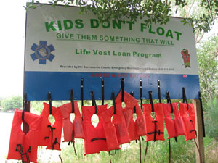
Life Jacket Loaner Boards - FREE
Borrowing stations along the public waterways in Sacramento County. Borrow one for you and your child and return it when you’re done.
American River Parkway (kids only)
Aquatic Center at Lake Natoma
Fire Station Loan Stations
Notes:
Borrow a life jacket
The "Kids Don't Float" life preserver loaner program provides jackets for temporary use that are hung on loaner boards along local waterways. There are also borrowing stations at some local fire stations.
River Loaner Boards - https://regionalparks.saccounty.gov/Rangers/Pages/KidsDontFloat.aspx
Fire Department loan stations - https://dbw.parks.ca.gov/?page_id=29179#sac

Slide 13
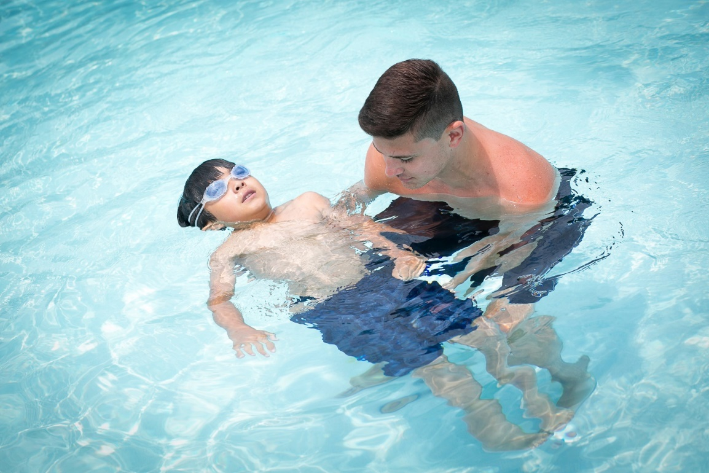
Learn to Float
Treading water is a way of staying afloat by calmly moving your arms and legs in wide circles.
Treading water allows you to catch your breath, assess the situation, and look around for the nearest safe place.
Notes:
Treading water is a way of staying afloat by calmly moving your arms and legs in wide circles.
Treading water allows you to catch your breath, assess the situation, and look around for the nearest safe place.
Floating down river - float on your back, feet first, with your toes up out of the water. Never try to stand up in swiftly moving water, your feet can be entrapped.

Slide 14
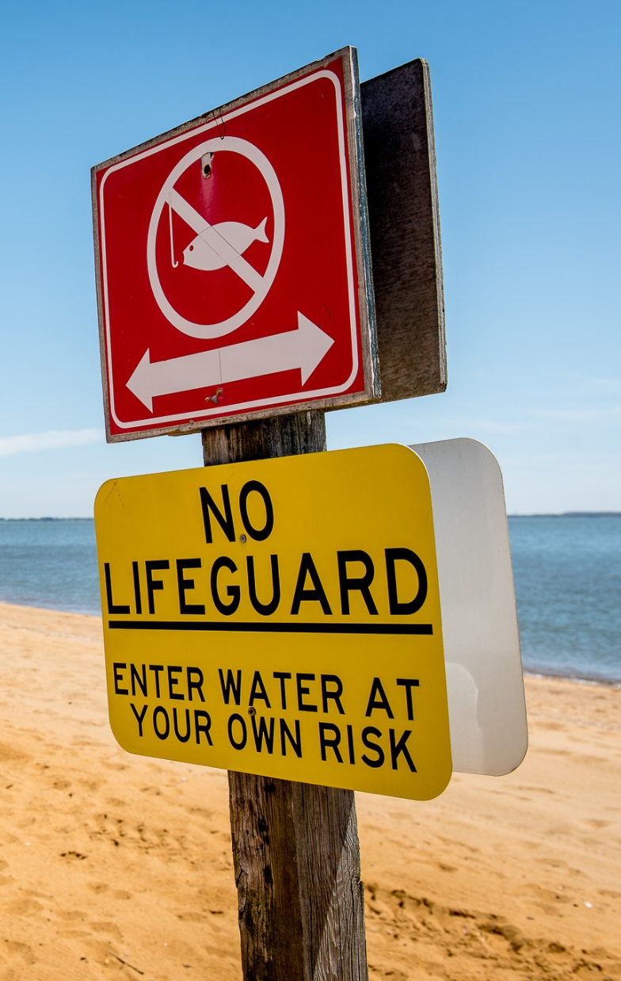
Look Before You Leap
Obey the signs – “No Swimming or No Diving”
Riverbeds can drop off sharply. Stay close to shore.
The surface may look smooth, but our rivers are fast and strong!
Ask yourself?
  Is the water deep enough?
  How cold is the water?
  Are there hazards under the water that I can’t see from the surface?
Notes:
Lesson 4: Look Before you Leap!
Before jumping in, enter the water slowly, feet first. If you are not familiar with the water, and cannot determine the depth or observe potential hazards, do not enter the water.
The water surface may look smooth, but the current and undertow can be strong.
Stay close to shore to avoid drop-offs and currents. While there may be a gradual slope as you enter the water near shore, there might be a sudden drop-off further out.
Never use rope swings or jump off bridges - No matter how deep the water is, these activities can result in serious injury or death
Don’t jump or dive into shallow water.
Hitting your head can have big consequences.
Don’t swim in an aqueduct or a canal. Swimming in a canal is against the law. If you enter a canal, you are trespassing and can be arrested or fined.

Slide 15
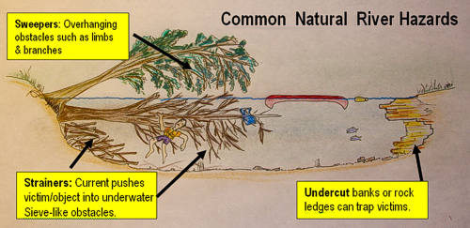
River Safety

Slide 16
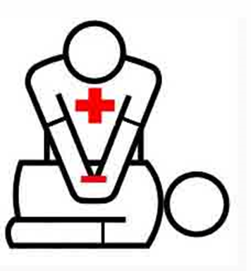
Learn to Rescue Safely
Know the signs of drowning. Drowning doesn’t look like it does in the movies.
To safely save someone, know how to reach, throw, or find an adult to row.
If you can’t rescue safely, go call 9-1-1 to get help.
Learn CPR for drowning, including rescue breaths. You can save a life.
Notes:
Always tell someone where you are going and how long you expect to be there.
Know the address of the location where you are swimming, or name of the park or beach.
Learn CPR
Know the signs of drowning:
Child cannot yell for help. Drowning is often depicted incorrectly in movies.
If adult calls to child or asks them if they are ok and they give no answer or look at adult with a blank stare, this may indicate child is struggling and needs assistance.
Head back and low in the water with mouth at water level
Not using legs; person is vertical in the water, often bobbing up and down
Accidents can happen at the pool, lake, river and ocean. To safely save someone, know how to reach, throw, or find an adult to row.
Rescue Safety Checklist:
Reach out with your hand, pool equipment, branch or other object to a person who is struggling in the water. Hold on to someone or something stable while you are reaching. Do not lean over the water while you are trying to save someone, you could get pulled into the water too. Keep a low center of gravity by staying low to the ground. If you are in a boat, make sure that most of your weight remains in the boat.
If you can’t reach the person, throw out something that will float, something the person can hold on to that will help him or her stay afloat until help comes. You can throw an empty ice chest, inner tube, PFD, or other object that floats.
If you can’t reach or throw, find an adult who can row out to the person. A large inner tube, an air mattress, surfboards, or raft are examples of what to row.
If you can’t reach, throw or find an adult to row, go call 9-1-1 to get help.
Don’t take your eyes off the person that needs help.

Slide 17
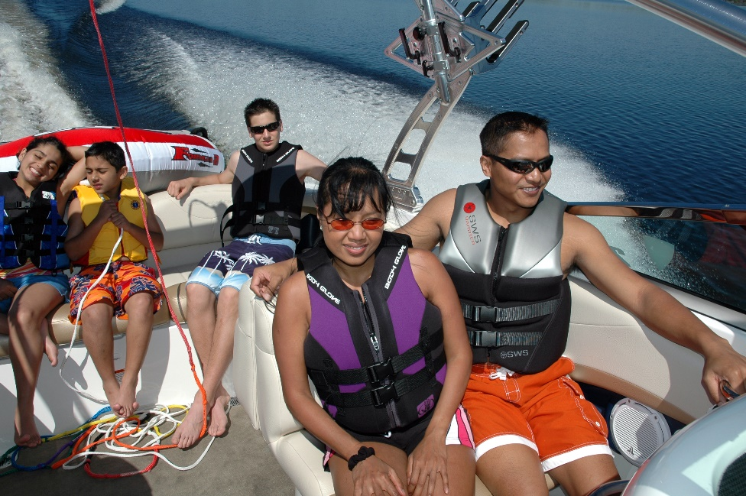
Don’t Overload Your Boat
An overloaded or unbalanced boat can turn over or capsize, even when there is no wind or rough water.
Maintaining stability and balance requires good judgement and safe behavior.
Photo: U.S. Coast Guard
Notes:
Lesson 6: Don’t overload your boat!
Overloading your boat is very dangerous. An overloaded or unbalanced boat can turn over or capsize, even when there is no wind or rough water. Entering or exiting a small boat can also be dangerous. If you plan to move, make sure someone else moves the opposite way to counterbalance the boat.
Keep your boat balanced by distributing weight evenly.
If a person must move, counterbalance to offset the change in weight distribution.
Be sure to secure gear to prevent it from shifting and unbalancing the boat.
Riding on the bow (front), transom (back), or gunwales (sides) may unbalance the boat.
Operating a boat safely by maintaining stability and balance requires good judgement and proper behavior. Limit the number of people on your boat to the number of passengers recommended on the boat’s capacity plate. The capacity plate tells you the maximum number of passengers and weight your boat can safely carry.

Slide 18
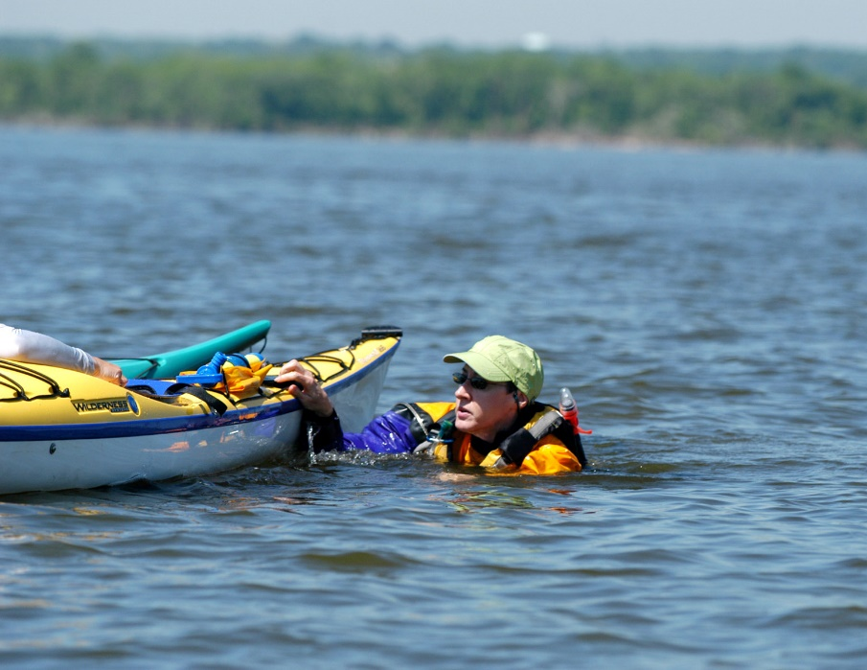
Stay With Your Boat
If your boat capsizes or turns over, stay with the boat, it is easier for rescuers to see.
Most boats have floatation built into them so they will not sink.
If help is nearby, yell, gesture, or use a whistle to attract attention.
If you can’t stay with your boat, grab onto anything that floats.
Photo: U.S. Coast Guard
Notes:
Lesson 7: Stay with your Boat!
There are safe and wise procedures to follow if you are in an accident and your boat capsizes or turns over.
If you boat capsizes, stay with the boat. It is easier for rescuers to see the boat than heads bobbing in the open water. Most boats have floatation built into them so they will not sink.
If in a lake or the ocean, do not try to swim to shore. Judging distance on the water is difficult, so the shore may appear to be closer than it is.
If you are in a river, stay with your boat if you can, lay on your back with your feet out of the water and down river.
If help is nearby, yell, gesture, or use the whistle attached to your PFD to attract attention. If help is far away, don’t yell. Save your energy and blow your whistle.
Grab onto anything that floats. To attract the attention of someone nearby, wave your arms slowly over your head and blow your whistle.
Don't follow your equipment downstream - Never risk your life to save equipment or belongings
To prevent hypothermia when you are in the water:
If you can, climb onto the boat’s hull as far out of the water as possible
Do not remove shoes or clothing
Keep your head out of the water
If there are other people with you, huddle together to keep warm
If you are alone, curl up into the fetal position. To curl up in the fetal position, bring your knees as close to your chin as possible, and hold onto your legs. This posture minimizes the amount of heat that escapes form your body, keeping you warmer.

Slide 19
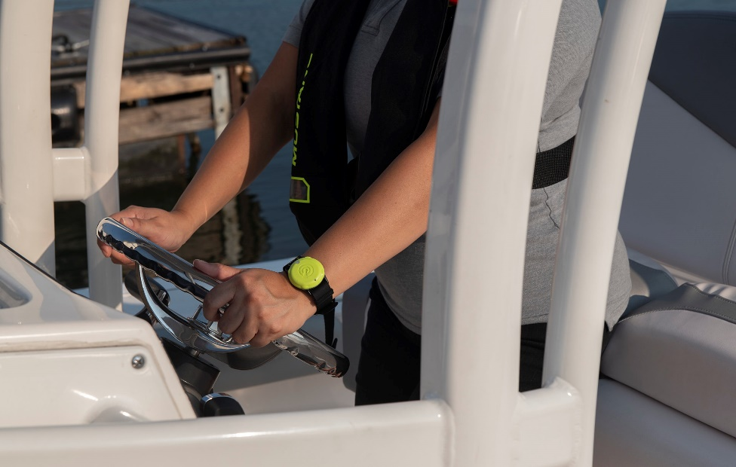
Learn the Rules of the Road
Register for a class with the CA Dept. of Boating and Waterways.
Boaters need to be courteous, safe, and follow the rules of the road.
Maintain safe speed and know the right-of-way.
Follow safe boating signs and recognize channel markers. Know navigation rules.
Photo: National Safe Boating Council
Notes:
Lesson 8: Learn the Boating & Jetski Rules of the Road!
There are rules for operating a boat in order to maintain safety for everyone on the water. Boaters need to be courteous, safe and follow the rules of the road.
Follow the rules when leaving or returning to the dock or launch
Maintain safe speed. Travel 5 mph or less within 100 feet of swimmers or within 200 feet of beaches, swimming flats, diving platforms, lifelines or docks.
Know the right-of-way when involved in crossing, passing, or overtaking other boats.
Do not block boats leaving or entering the water
Follow safe boating signs and recognize channel markers
Observe red (starboard, right) and green (port, left) channel markers when headed upstream or returning from the ocean.
Remember, an orange diamond on a buoy means danger.
Know navigation rules.
Use a whistle, bell, or other sound-producing device: one blast to pass on my left (port side), two blasts to pass on my right (starboard side), one blast to pass on the right (port to port) when meeting head-to-head.
All persons aboard a jet ski regardless of age must wear an appropriate life-jacket.
Life jackets must be USCG approved for jet skis.
Do not operate boats and jetskis near swimmers in the water.
In Sacramento County, there are many no-wake zones, including near most local public marinas as well as the entire American River.

Slide 20
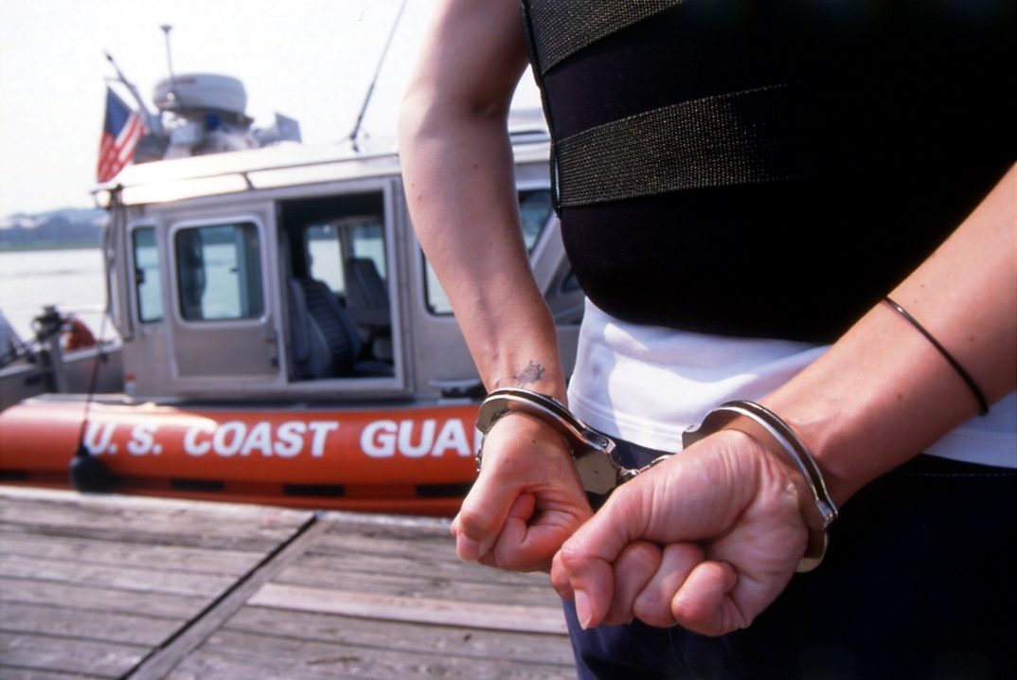
Alcohol, Drugs, and Boating Don’t Mix
Using alcohol or drugs can make your judgement poor, slow your response time, and reduce your ability to response to dangerous incidents.
It is illegal to operate a boat with a blood alcohol level of 0.08% or more, and 0.01% for those under age 21.
Photo: U.S. Coast Guard
Notes:
Lesson 9: Alcohol, Drugs, and Boating Don’t Mix!
Drinking alcohol and using other drugs while boating cause many boating accidents. Using alcohol or drugs by themselves can make your judgement poor and slow your response time-and reduce your ability to respond to dangerous incidents.
It is unlawful to operate a boat while under the influence of alcohol or other drugs
The blood alcohol concentration indicates if a person is driving under the influence
It is illegal to operate a boat with a BAC of 0.08% or more.
Four youths under the age of 21 years, it is illegal to drink alcohol and operate a car or boat with a BAC of 0.01% or more. It can jeopardize your privilege of obtaining or keeping a driver’s license
The boating conditions that increase the impact of alcohol and other drugs are called stressors
There are 4 main stressors: sun, wind, noise and waves (or movements).
The stressors increase the effects of alcohol and other drugs on your sense of balance, vision, judgement, and reaction time.

Slide 21
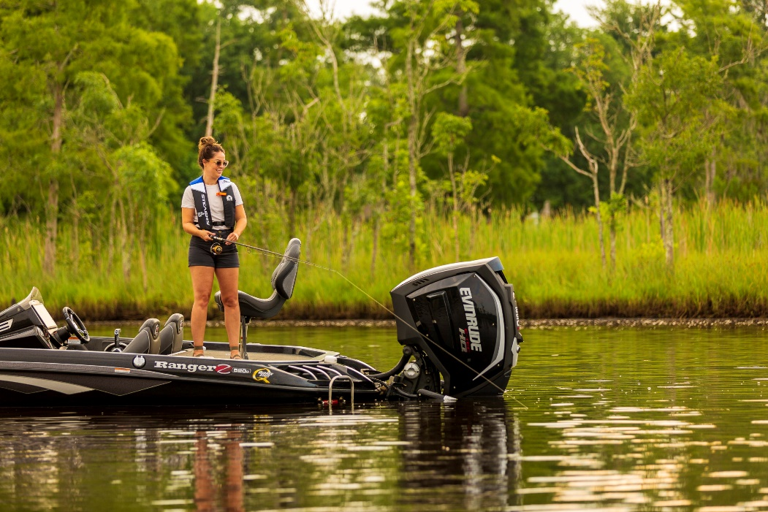
Keep our Waterways Clean
People, plants, and animals depend on clean, safe water.
Learn to properly dispose of waste products.
Wash hands/shower after swimming and DO NOT drink river water.
Avoid open water if you have open cutes or sores, or are immuno-suppressed.
Photo: National Safe Boating Council
Notes:
Lesson 10: Keep our Waterways Clean!
Keeping our waterways clean is very important not only for recreation purposes but also for the environment. People, plants and animals depend on clean, safe water. Why keep our waterways clean?
All living things require water to live
California is an agricultural state, requiring vast quantities of water to grow food.
Water is an important resource for recreation: boating, fishing and other water sports
Water pollution and non-native species have a negative impact on the pleasure of boating.
Destroy native wildlife and wildlife habitat
Eliminate bodies of water as a recreational resource
Water pollution has a negative impact on our daily lives.
Decreases the amount of water available for agriculture
Affects our health and well-being.
Let’s do our part! Common waterway pollutants include:
Fishing and hunting products such as lead shot and weights, fishing line, and fishing hooks
Oil and fuel spills
Packaging and food containers such as aluminum, paper, Styrofoam, and plastic products such as sixpack rings, utensils, cups, plates, and bags
Food scraps that either poison the wildlife or pollute the water
Human waste
Sewage discharges, industrial wastes
Learn to properly dispose of waste products:
Plastics, Styrofoam’s, aluminum, and paper should be recycled.
Food and vegetative wastes should be composted
Human waste should be properly disposed of at a pump out or dump station
Boaters should use floating restrooms, or when they are not available bathrooms on shore
Oil and fuel spills can be avoided by fueling before dark, filling portable tanks on the dock instead of in the boat, keeping the fill nozzle in contact with the fuel tank, wiping up spilled gas, and discarding fuel-soaked cloth in a sealed container. Do not leave the gasoline pump unattended while it is dispensing fuel.
Oil and fuel should never be dumped in storm drains because storm drains empty directly into the ocean, rivers and bays.
Respect the plant and animal inhabitants - Do not bother animals, and watch out for stinging insects and poison oak
Follow healthy water habits
Actively supervise children and pets in or near water.
Avoid algae blooms (brightly colored water) and trash in the water.
People with immuno-suppressive diseases should avoid direct contact with the river.
Wash hands/shower after swimming.
DO NOT drink river water, cook or wash dishes with river/lake water, change diapers in or near water, swim when you are sick, enter the water if you have cuts or open sores as these are pathways for bacteria to enter your body, or enter the water for several days after a significant rainstorm as storm flows spike bacteria levels.

Slide 22
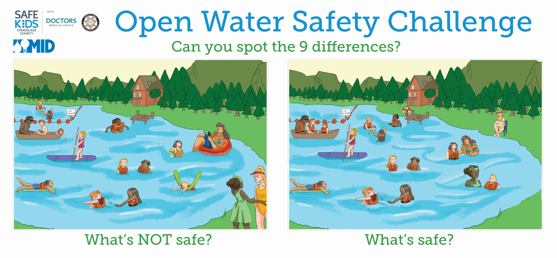
☹
☺
Notes:
Graphic provided by the Modesto Irrigation District and Safe Kids Stanislaus County

Slide 23
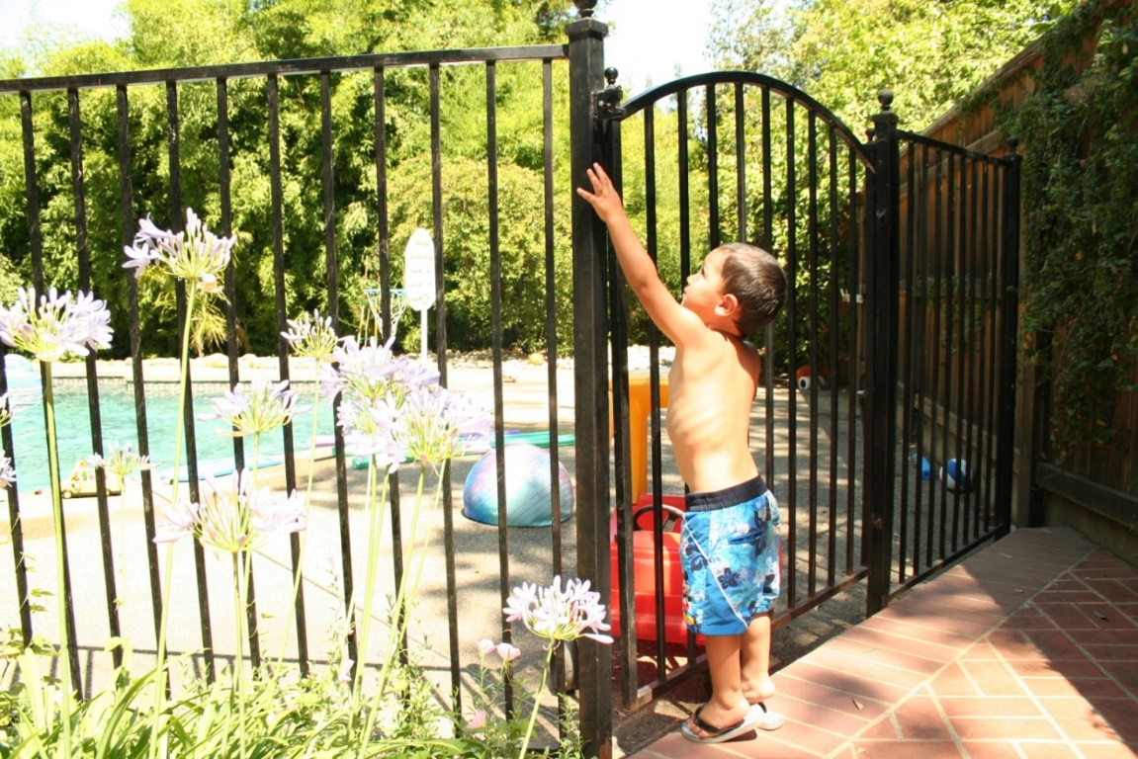
Pool Safety
Step 1 is Adult Supervision
Step 2 is Barriers
Step 3 is CPR & Classes
Notes:
1
Supervision during non-water activities
Children drown without a sound
Many children who drowned in swimming pools were not expected to be in or around water so know where your children are at all times.
Empty all tubs, buckets, containers, kiddie pools immediately after use and turn them upside down
Supervision during water activities
Children should be watched by a responsible adult 100% of the time they are in or near the water.
2
The only proven effective barrier is a 5 feet tall non-climbable fence with self-closing, self-latching gates that completely encloses the pool.
Secondary barriers include alarms and pool & spa covers
Install, inspect and always use barriers
Self-Closing, Self Latching means it is spring loaded therefore it does not require a person to push or latch it closed
Other layers, such as alarms provide warnings. They should be supplemental in that they can run out of batteries or you can get ‘used’ to the sound.
They warn an adult that someone got out of the back door, but don’t stop a child from entering the water.
There are approved safety covers that prevent access to water, but it takes a person to put it on. What if you forget?
Don’t try to be an expert on barriers.
3
Learn CPR (Cardiopulmonary Resuscitation) and rescue breathing.
Start CPR and rescue breathing at pool side.
To find CPR classes ask the Red Cross, American Heart Association, parks and recreation district or family resource center.
Starting CPR at poolside also helps decrease potential brain damage. Every second counts.
Enroll all children and adults in your family in swim lessons and water safety training, but remember these classes never take the place of supervision or barriers!
To find swimming classes ask at a local community pool, parks and recreation district or family resource center.

Slide 24




Communications
Notes:
Follow us on social media for more child safety tips!
Facebook – Safe Kids Greater Sacramentp
Instagram - @safekidsgrgreatersacramento
Our website is www.safekidssacramento.org

Slide 25

Post-Survey
https://bit.ly/OpenWaterPostSurvey
Coalition Number: 27020
State: California
Notes:
Please help us improve this program by taking a short survey on what you learned today.
Presenters – distribute and collect paper surveys or have participants visit survey link. If they use link, they will need the coalition number listed above.

Slide 26

Thank You!
Jennifer Rubin
Safe Kids Coordinator
Mercy San Juan Medical Center
916-864-5684
Jennifer.Rubin@dignityhealth.org
www.safekidssacramento.org

Slide 27
Child Drownings
Myths and Facts
Share it with a friend! If you heard a water safety myth from a friend or family member, how would you answer them with what you have learned today?
Role playing exercise, Part 1
Notes:
Optional activity if you have time. Read directions on slide.

Slide 28
Child Drowning
Myths and Facts – Part 1
Myth: “Drowning takes a long time.”
Fact: Children lose consciousness in 30 seconds or less. If a child is missing, always check the pool or other water sources first. Every second counts!

Slide 29
Child Drowning
Myths and Facts – Part 1
Myth: “As long as there are other adults around, children are safe.”
Fact: Children can drown even though they are surrounded by adults.

Slide 30
Child Drowning
Myths and Facts – Part 1
Myth: “My child can’t get to the pool/water by himself yet.”
Fact: Children don’t announce when they’ve mastered something new. Just because your child could not open a sliding glass door yesterday, does not mean he or she can’t today.

Slide 31
Child Drowning
Myths and Facts – Part 1
Myth: “Drownings only happen to families who don’t know better.”
Fact: Drownings occur in every neighborhood, socioeconomic and ethnic group, regardless of education level.

Slide 32
Child Drowning
Myths and Facts
Role playing exercise, Part 2

Slide 33
Child Drowning
Myths and Facts – Part 2
Myth: “It can’t happen to me. I’m a good parent.”
Fact: All parents whose children have drowned felt this way. No one believes a drowning could happen to their child or the children under their care. Without layers of protection, no child is safe from the tragedy of drowning.

Slide 34
Child Drowning
Myths and Facts – Part 2
Myth: “My child is safe because he’s had swimming lessons.”
Fact: When a child enters a pool alone, he may not behave the same way he does in a swimming lesson because no one is there to cue him to swim or behave in a certain manner.

Slide 35
Child Drowning
Myths and Facts – Part 2
Myth: “I’ll hear my child if he’s in trouble.”
Fact: Drowning is a silent event. Drowning children don’t splash, cry, or call out for help. “Kids drown without a sound”.

Slide 36
Child Drowning
Myths and Facts – Part 2
Myth: “My child is safe because he’s inside the house with me.”
Fact: Don’t assume your child is safe because you last saw him napping or playing. Toddlers move fast. Unless the child is within your direct sight, there is the possibility he is in the water.

Slide 37
Refugee Agency Presentations
Notes:
Slides 37-41 are for refugee resettlement agencies only. Swim lesson funds are available at the Fulton-El Camino Rec and Park District only.

Slide 38
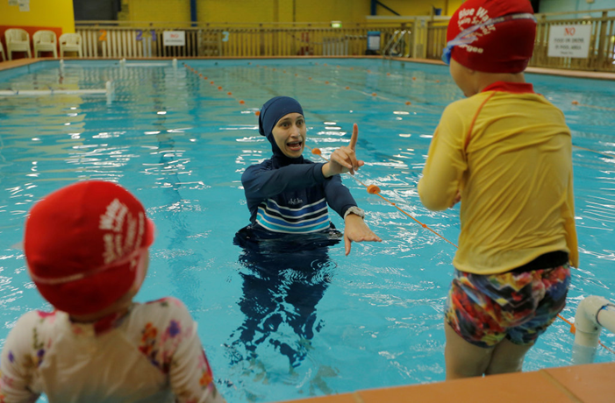
Swim Lessons
Swimming lessons are the process of learning to swim
Happens in the pool, at a park
Instructors work for local government Recreation and Park District
Instructors are typically local high school or college students
Small groups, 1 instructor for every 4 or 5 children

Slide 39
Swim Lessons
Parents or caregivers may sit in designated area and watch lessons
Religious garments may be worn in shallow end of pool
Lessons may include:
  Swim test on the first day, determines swim skill level
  Getting comfortable with water, face in water
  Skills - kicking legs, front and back floating, blowing bubbles, basic arm strokes
  Equipment - foam kick-boards, flotation devices, rings and other toys

